Slide 1

INTERNSHIP STUDIO
Finance Internship
PROJECT 1
A comprehensive financial analysis of TATA CONSULTANCY SERVICE (TCS)
BY SURAJ KUMAR PRASAD

Slide 2
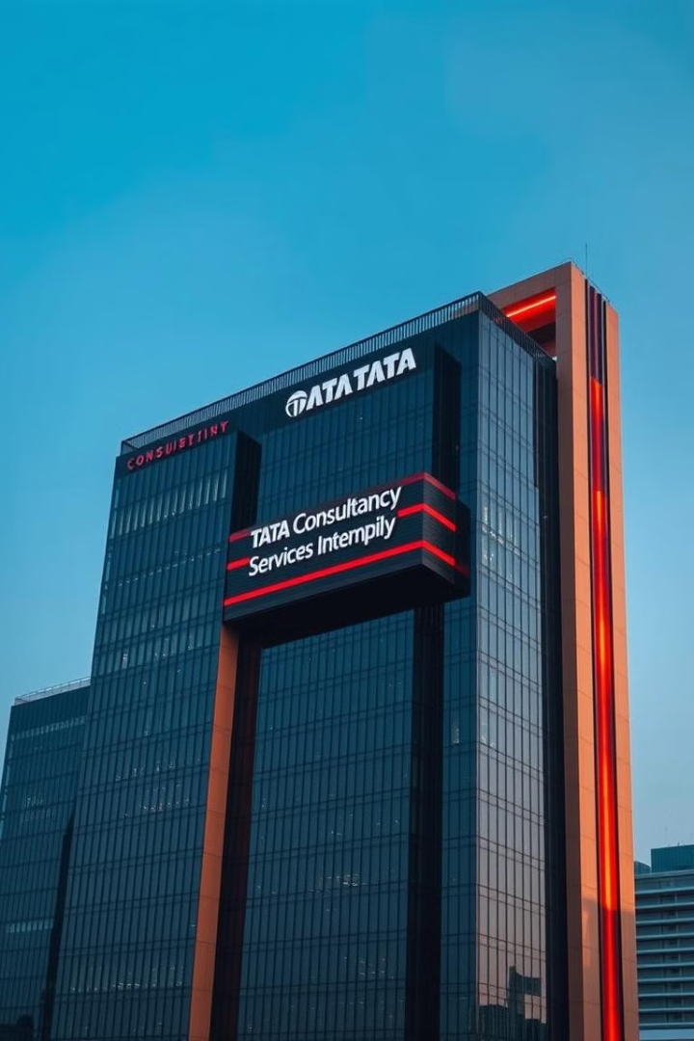
Tata Consultancy Services (TCS)
Tata Consultancy Services (TCS) is one of the world’s leading IT services, consulting, and business solutions organizations. Founded in 1968 and headquartered in Mumbai, India, TCS is a part of the Tata Group, one of India's largest and most respected business conglomerates. The company offers a wide range of services including IT services, consulting, digital transformation, cloud computing, and cybersecurity. With a global presence in over 45 countries and a workforce of more than 600,000 employees as of 2024, TCS serves numerous Fortune 500 companies. Known for its innovation, strong delivery model, and commitment to quality, TCS plays a significant role in driving digital transformation across industries. The company is publicly listed on the Bombay Stock Exchange (BSE) and the National Stock Exchange (NSE) in India.

Slide 3
Financial statements of TCS
2023-24
Consolidated statement of balance sheet
Consolidated statement of profit and loss
Consolidated statement of change in equity
Consolidated statement of cash flow

Slide 4
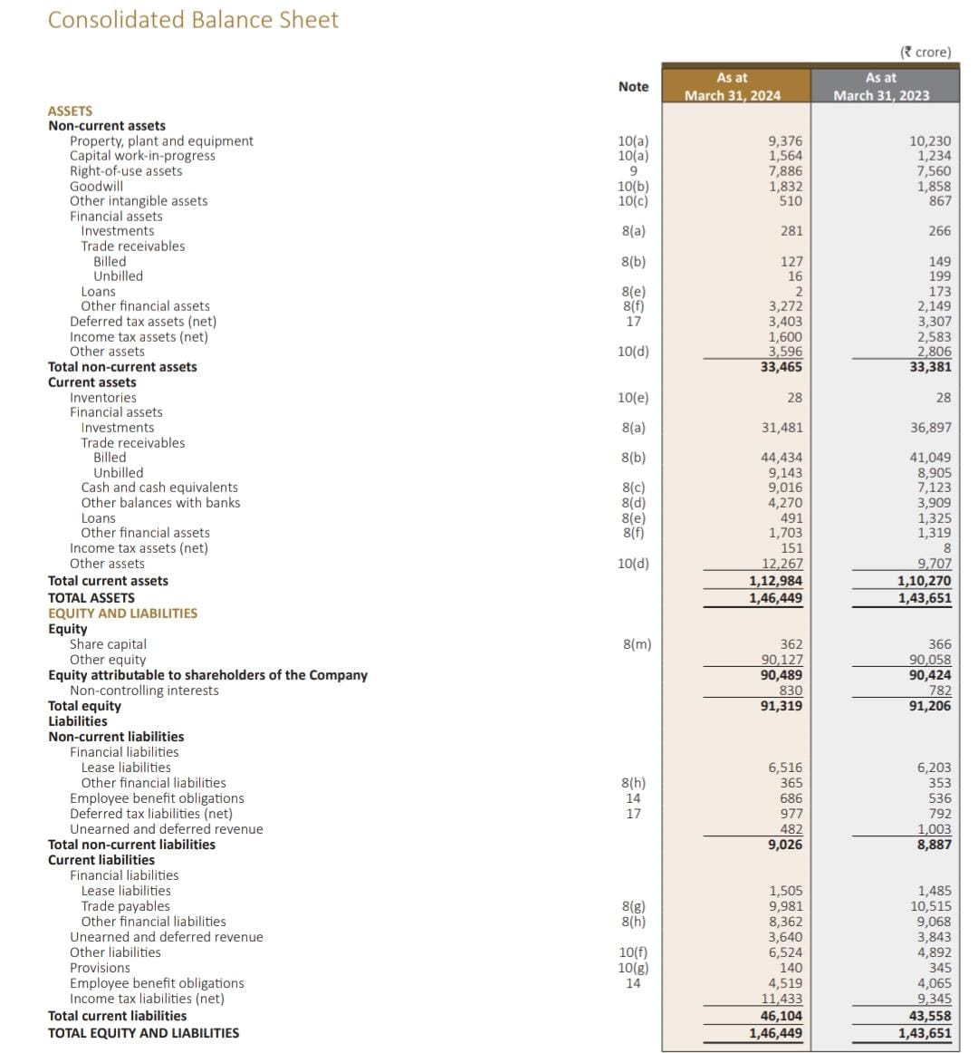
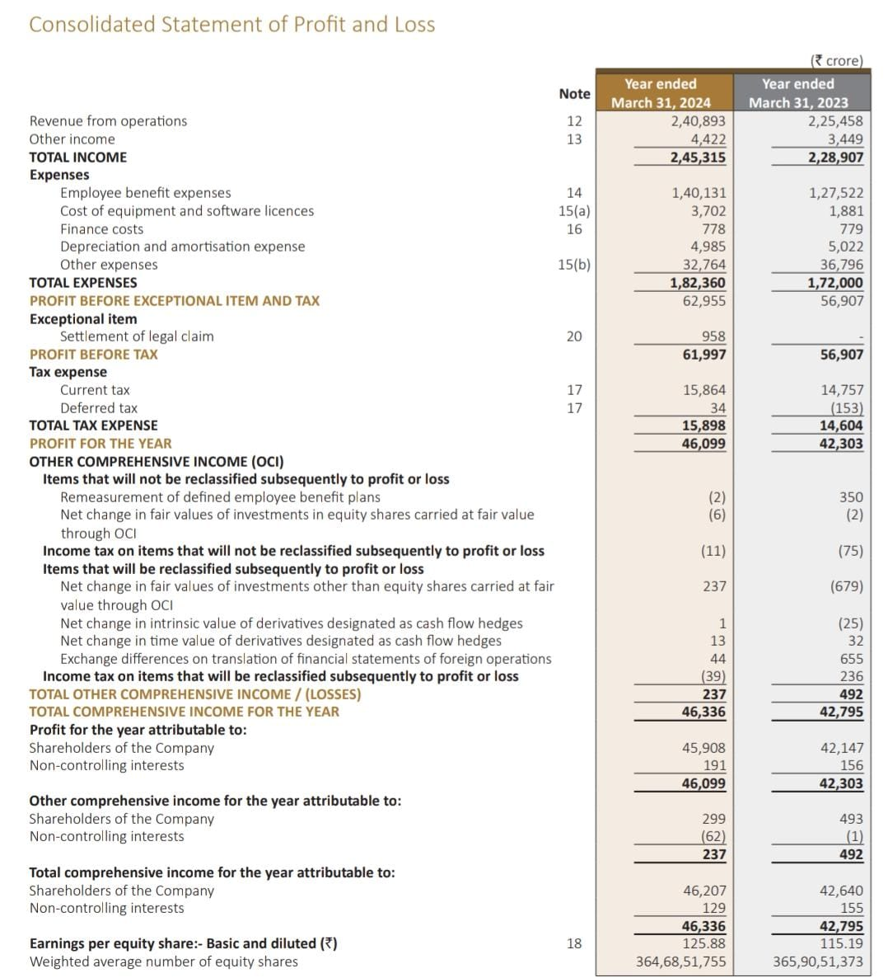

Slide 5
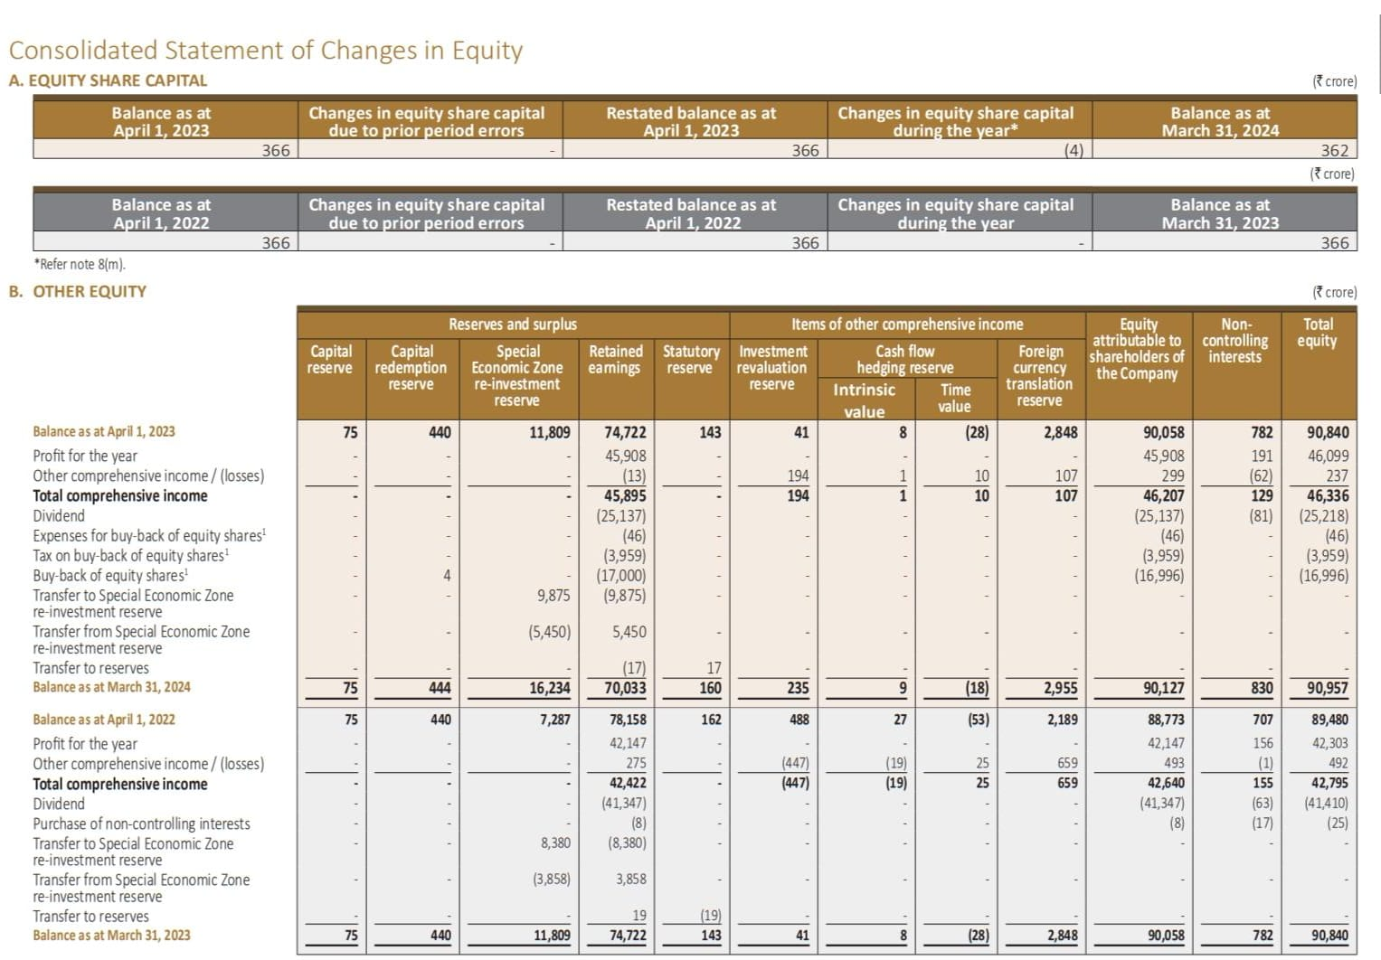

Slide 6
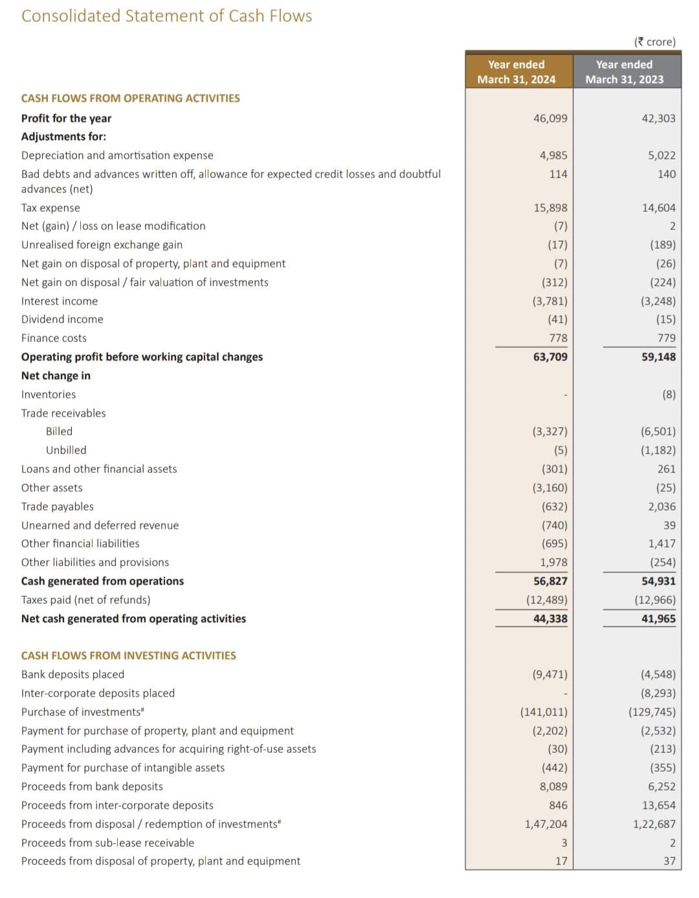
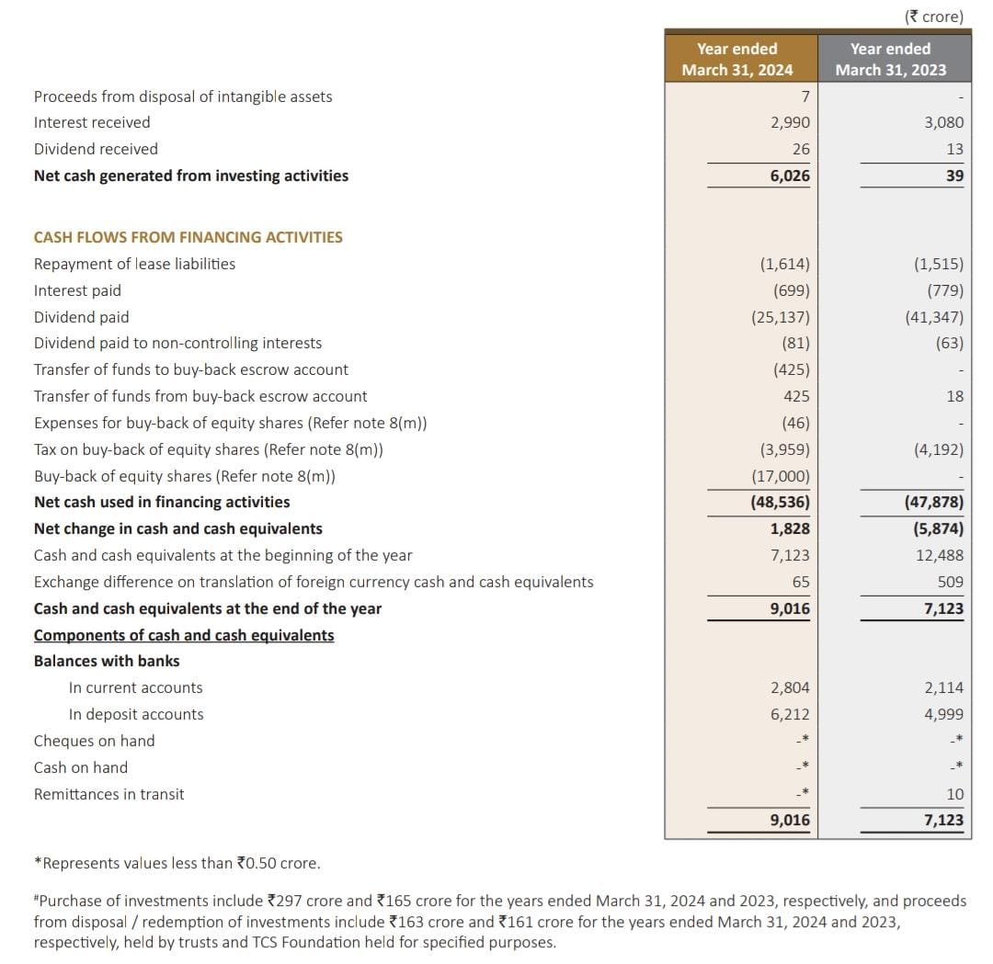

Slide 7

TCS FY 2023-24 Annual Report
Detailed insights from the TCS FY 2023-24 annual report. Understand the financial statements and key performance indicators. This report serves as an important resource for investors.
Revenue
Net Income
EPS
₹240,893 Crores
₹45,908 Crores
₹125.98

Slide 8

Liquidity Analysis
Current ratio
112984 / 46104 (in cr) = 2.45 : 1
Current ratio of 2.45 in 2024 indicates strong liquidity
and financial stability, showing the company is well-positioned
to meet its short-term obligations and manage operations
efficiently. For investors, this reflects low financial risk and a
stable foundation for sustained growth.
Quick ratio
112956/46104 (in cr) = 2.45:1
It indicates excellent short-term liquidity, showing it can
comfortably meet its immediate obligations without
relying on inventory.

Slide 9


Profitability Ratios
Return on equity:
46099 / 90489 * 100 = 50.94%
TCS's ROE of 50.94% means it generated strong profits
using shareholders' equity efficiently, Reflecting
excellent financial performance and investor appeal.
Net Profit Margin: 19.3%
48553 / 250162 * 100 = 19.3%
​TCS’s net profit margin of 19.3% in FY 2024 shows it earned ₹19.3
in profit for every ₹100 of revenue, highlighting strong cost control
and overall profitability.

Slide 10

Solvency ratio
Debt to equity ratio
0 / 90489 = 0
TCS's Debt-to-Equity Ratio of 0 for FY 2023-24 reflects its strong financial position, operating entirely on shareholders' equity without leveraging debt. This conservative financial strategy highlights the company's stability and prudent management.

Slide 11
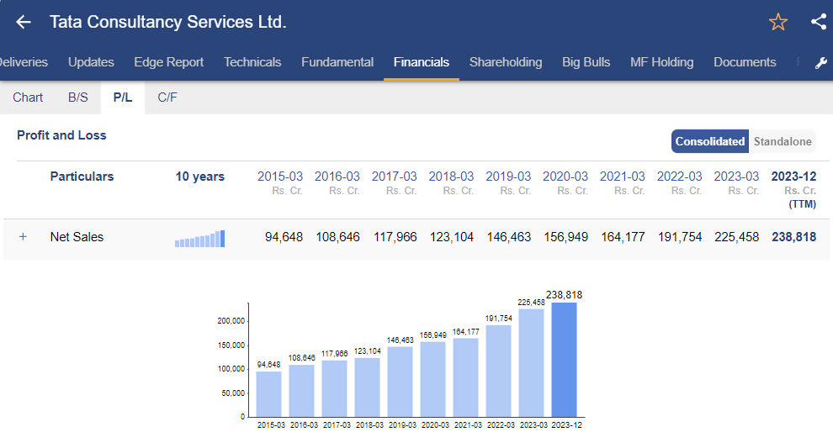

Slide 12
Analyzing Tata Consultancy Services' (TCS) financial ratios over the past two fiscal years (FY 2022-23 and FY 2023-24) provides insights into its financial health and performance relative to industry benchmarks.​
Return on Equity (ROE):
FY 2022-23: 45.80%​ FY 2023-24: 50.94% ​
TCS's ROE has shown a significant increase, indicating enhanced profitability and efficient utilization of shareholder equity. This performance surpasses many industry peers, reflecting TCS's strong market position.​
Net Profit Margin:
FY 2022-23: 18.2% ​FY 2023-24:19.3%
​The net profit margin's steady growth suggests effective cost management and robust revenue generation, positioning TCS favorably within the IT services sector.​2.
Current Ratio:
FY 2022-23: 2.36​ FY ​2023-24: 2.45
While there's a slight decline, TCS maintains a strong current ratio, indicating a solid ability to meet short-term liabilities. This remains competitive compared to industry standards.​
Debt-to-Equity Ratio:
FY 2022-23: 0.00​ FY 2023-24: 0.00 ​
TCS operates with zero debt, underscoring its conservative financing strategy and financial stability, a notable strength in the industry.

Slide 13



Market Position and Competitive Advantages
TCS's market leadership and competitive strengths. TCS is a leader in IT Services and Consulting, as per IDC MarketScape report. TCS also has robust digital transformation capabilities.
Market Leader
Strong Brand
Client Base
Diverse Industries
Digital
Transformation

Slide 14
✅ Strengths:
TCS shows strong profitability with a Return on Equity of 50.94% and a Net Profit Margin of 19.3%, meaning it's efficiently generating high profits. It has zero debt, which reduces financial risk, and a healthy current ratio of 2.20, indicating solid short-term liquidity. The company is also using its assets well, with a Return on Assets of 35.95%.
⚠️ Weaknesses/Potential Risks:
There’s a slight dip in liquidity compared to the previous year, and TCS’s heavy dependence on global markets (like the US and Europe) could affect revenue during geopolitical or economic issues. Also, it trades at a premium valuation, so any slowdown in performance could affect investor sentiment.
🌟 Opportunities:
TCS can grow further through its focus on AI, cloud, and digital transformation services. Global demand for IT services is rising, and TCS’s strong client base and long-term contracts offer consistent revenue and expansion potential.

Slide 15
💡 Investor Verdict
TCS is a financially robust, low-risk, and high-performing company with strong long-term potential. While global exposure and premium valuation are factors to watch, its strong balance sheet, debt-free status, and rising profitability make it an attractive choice for both growth and value investors.

Slide 16
THANK YOU

Slide 17

INTERNSHIP STUDIO
Finance Internship
PROJECT 2
A comprehensive financial analysis of LuxeBlend Co.
BY SURAJ KUMAR PRASAD

Slide 18
Overview
Company Name : LuxeBlend Co.
Industry : Consumer Goods – Premium Beverages
Core Products/Services: Artisan cold brew coffee in eco-friendly glass bottles
Limited-edition seasonal beverage blends
Coffee brewing accessories (grinders, mugs, pour-over kits)
Subscription service for monthly product deliveries
Market Positioning: LuxeBlend Co. is a boutique beverage brand positioned in the premium/luxury segment. It targets urban millennials and Gen Z professionals who are style- conscious and eco-aware. Think of it as the “Apple of cold brew” – sleek packaging, exclusive drops, and high perceived value.

Slide 19
Fictional Characteristics Making It Interesting for Financial Analysis:
Rapid growth through e-commerce and social media influencers
High product margins but expensive customer acquisition
Seasonal revenue spikes
Recently expanded into retail stores
Balance of physical product production and brand-driven marketing

Slide 20
Key Financial Ratios
Liquidity Ratios
Current Ratio = ₹3,15,40,000 / ₹1,32,80,000 = 2.38
Quick Ratio = (₹3,15,40,000 - ₹83,00,000) / ₹1,32,80,000 = ₹2,32,40,000 / ₹1,32,80,000 = 1.75
✅ Interpretation: LuxeBlend has more than enough liquidity to cover its short-term liabilities. A quick ratio above 1.5 is great — it means the company isn’t overly reliant on selling inventory to stay solvent.

Slide 21

Profitability Ratios
Net Profit Margin = ₹99,60,000 / ₹12,45,00,000 = 8%
Return on Equity (ROE) = ₹99,60,000 / ₹3,32,00,000 = 30%
✅ Interpretation: LuxeBlend runs a healthy business with strong
profits relative to revenue. A 30% ROE is exceptional, indicating that
the company is using investor money effectively to generate returns.

Slide 22
Solvency Ratio
Debt-to-Equity Ratio = ₹2,65,60,000 / ₹3,32,00,000 = 0.8
✅ Interpretation: A debt-to-equity ratio of 0.8 shows LuxeBlend is leveraging debt wisely for growth while staying financially stable.
Investor Insights
Liquidity: Strong buffer to handle short-term business cycles or supply chain delays
Profitability: Attractive returns for investors, especially in a luxury niche
Solvency: Balanced use of debt — safe but ambitious

Slide 23
SUMMARY
LuxeBlend Co. is a strong product-based brand with premium positioning, solid financial performance, and attractive returns. Investors can see a well-run company with potential for long-term growth, especially if it can continue to balance margin pressures with its lifestyle brand appeal.

Slide 24


